Slide 1
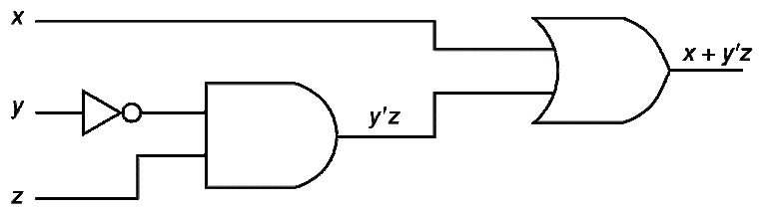
3.5 Digital Components (1 of 8)
The main thing to remember is that combinations of gates implement Boolean functions.
The circuit above implements the Boolean function F(x,y,z) = x + y’z:
We simplify our Boolean expressions so that we can create simpler circuits.

Slide 2
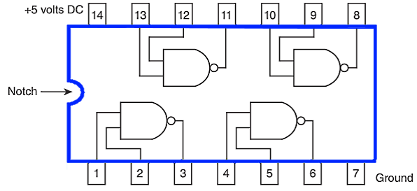
3.5 Digital Components (2 of 8)
Standard digital components are combined into single integrated circuit packages.
Boolean logic can be used to implement the desired functions.

Slide 3
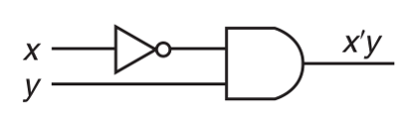
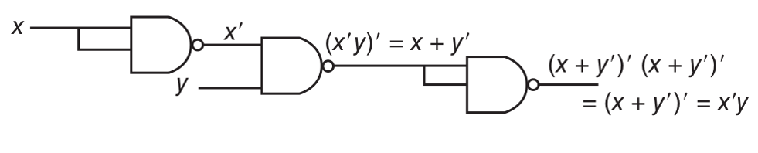
3.5 Digital Components (3 of 8)
The Boolean circuit:
Can be rendered using only NAND gates as:

Slide 4
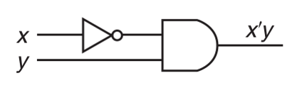
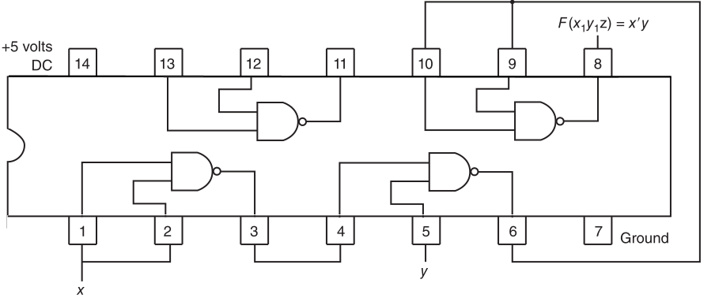
3.5 Digital Components (4 of 8)
So we can wire the pre-packaged circuit to implement our function:

Slide 5
3.5 Digital Components (5 of 8)
Boolean logic is used to solve practical problems.
Expressed in terms of Boolean logic practical problems can be expressed by truth tables.
Truth tables can be readily rendered into Boolean logic circuits.

Slide 6
3.5 Digital Components (6 of 8)
Suppose we are to design a logic circuit to determine the best time to plant a garden.
We consider three factors (inputs):
(1) time, where 0 represents day and 1 represents evening;
(2) moon phase, where 0 represents not full and 1 represents full; and
(3) temperature, where 0 represents 45°F and below, and 1 represents over 45°F.
We determine that the best time to plant a garden is during the evening with a full moon.

Slide 7
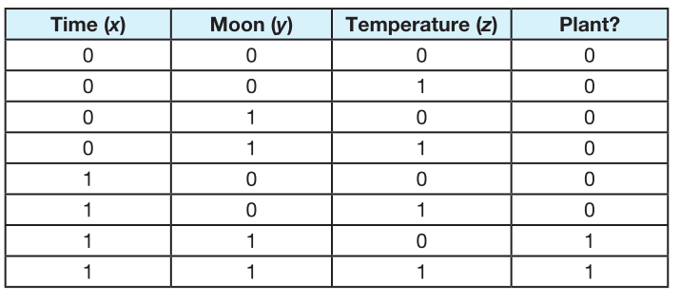
3.5 Digital Components (7 of 8)
This results in the following truth table:

Slide 8

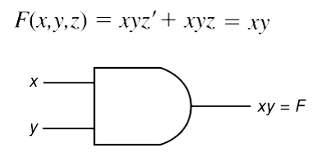
3.5 Digital Components (8 of 8)
From the truth table, we derive the circuit:

Slide 9
3.6 Combinational Circuits (1 of 12)
We have designed a circuit that implements the Boolean function:
This circuit is an example of a combinational logic circuit.
Combinational logic circuits produce a specified output (almost) at the instant when input values are applied.
Later, we will explore circuits where this is not the case.

Slide 10
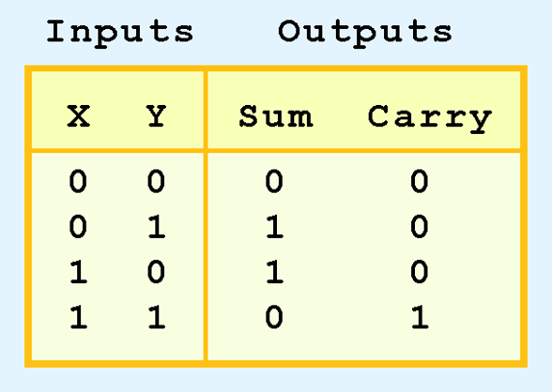
3.6 Combinational Circuits (2 of 12)
Combinational logic circuits give us many useful devices.
One of the simplest is the half adder, which finds the sum of two bits.
We can gain some insight as to the construction of a half adder by looking at its truth table, shown at the right.

Slide 11
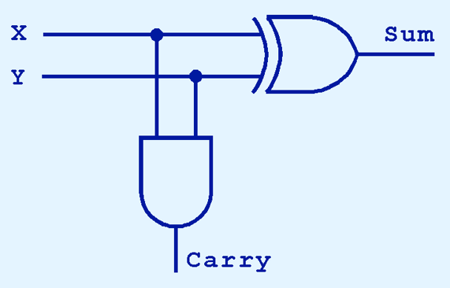
3.6 Combinational Circuits (3 of 12)
As we see, the sum can be found using the XOR operation and the carry using the AND operation.

Slide 12
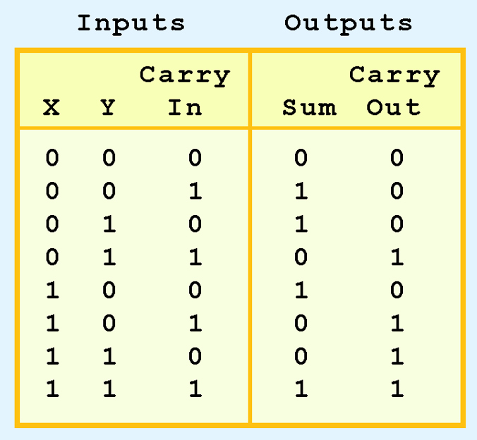
3.6 Combinational Circuits (4 of 12)
We can change our half adder into to a full adder by including gates for processing the carry bit.
The truth table for a full adder is shown at the right.

Slide 13
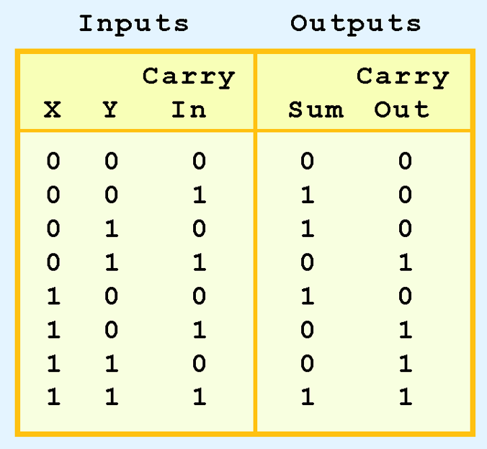
3.6 Combinational Circuits (5 of 12)
How can we change the half adder shown below to make it a full adder?

Slide 14
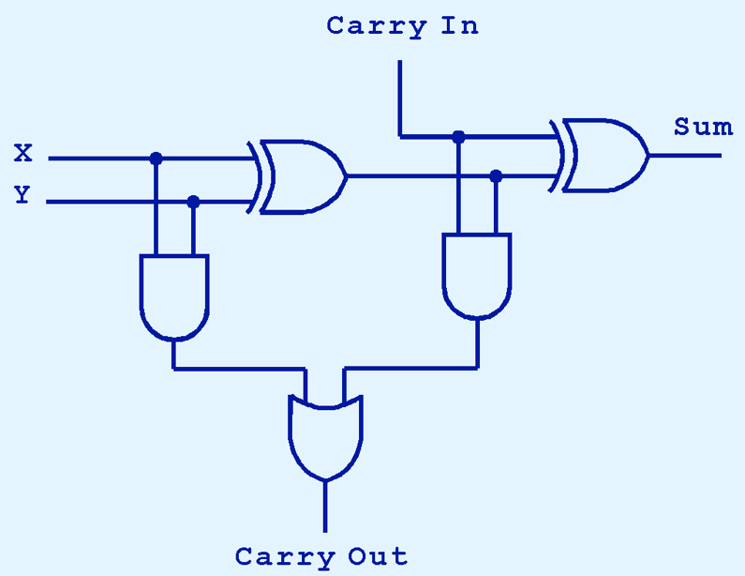
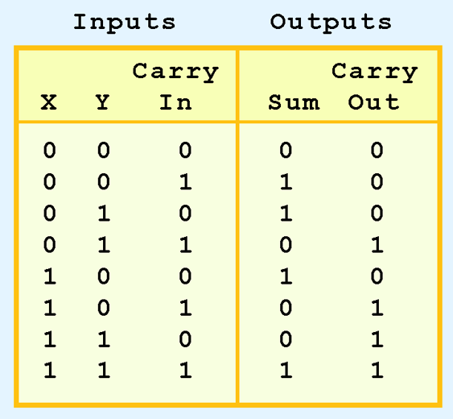
3.6 Combinational Circuits (6 of 12)
Here’s our completed full adder.

Slide 15

3.6 Combinational Circuits (7 of 12)
Just as we combined half adders to make a full adder, full adders can connected in series.
The carry bit “ripples” from one adder to the next; hence, this configuration is called a ripple-carry adder.
Today’s systems employ more efficient adders.

Slide 16
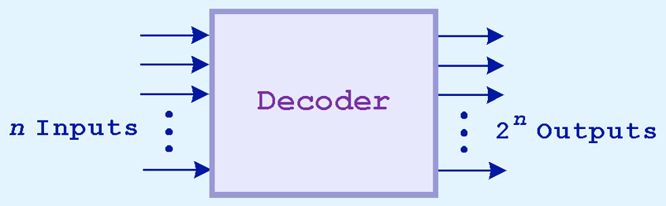
3.6 Combinational Circuits (8 of 12)
Decoders are another important type of combinational circuit.
Among other things, they are useful in selecting a memory location according a binary value placed on the address lines of a memory bus.
Address decoders with n inputs can select any of 2^{n} locations.
This is a block diagram for a decoder.

Slide 17
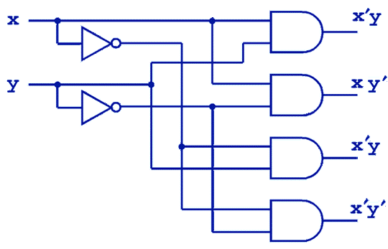
3.6 Combinational Circuits (9 of 12)
This is what a 2-to-4 decoder looks like on the inside.
If x = 0 and y = 1, which output line is enabled?

Slide 18
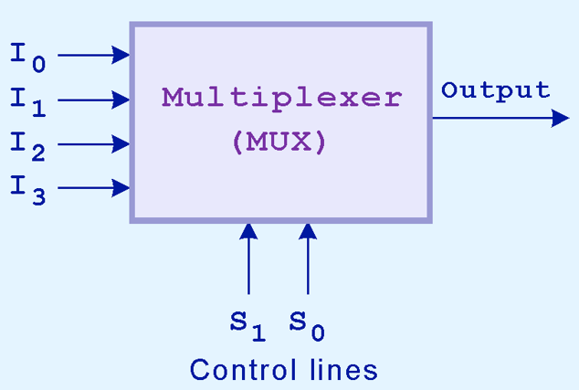
3.6 Combinational Circuits (10 of 12)
A multiplexer does just the opposite of a decoder.
It selects a single output from several inputs.
The particular input chosen for output is determined by the value of the multiplexer’s control lines.
To be able to select among n inputs, log₂n control lines are needed.
This is a block diagram for a multiplexer.

Slide 19
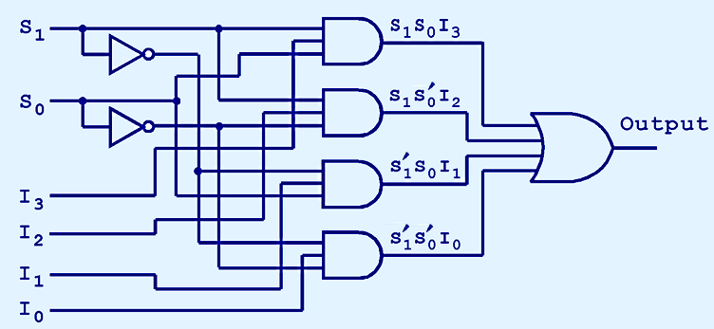
3.6 Combinational Circuits (11 of 12)
This is what a 4-to-1 multiplexer looks like on the inside.
If S₀ = 1 and S₁ = 0, which input is transferred to the output?

Slide 20
One Bit ALU
We will use what we learned so far to build a one bit arithmetic logic unit (ALU).

Slide 21
4 blocks we will use in our 1-bit ALU

Slide 22
Logic Operations (1)
Let us start by the logical operations, because they map directly to the gates from the previous figure.

Slide 23
Logic Operations (2)
The multiplexer selects a AND b or
a OR b
depending on whether the value of the Operation is 0 or 1

Slide 24
Arithmetic Operations 1-bit full Adder
We previously saw the implementation of the full adder

Slide 25
One – Bit ALU
This is a one-bit ALU that we derived by combining the logic operations with the full adder.
The Operation (selector) now should have two bits.

Slide 26
32-bit ALU

